Slide 1
Software Development
Chapter 1

Slide 2
Chapter Contents
1.1 Problem Analysis and Specification
1.2 Design
1.3 Coding
1.4 Testing, Execution, and Debugging
1.5 Maintenance

Slide 3
Chapter Objectives
Introduce software development approaches
Contrast software development in programming course with real world
Study top-down, objected oriented approaches
Introduce design aspects
Select or build data types
Develop algorithms for operations on data
Investigate error types
Emphasize importance of testing
Note time and effort devoted to maintenance

Slide 4
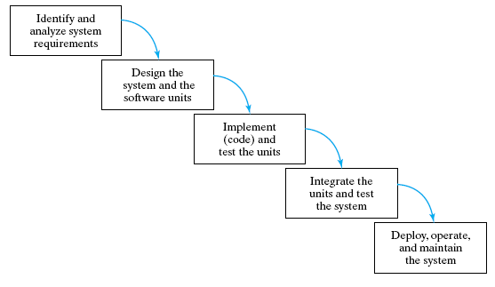
5 Phases of Software Life Cycle
Waterfall Model

Slide 5
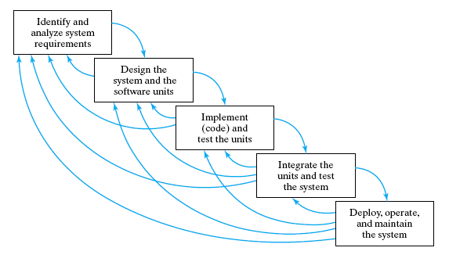
5 Phases of Software Life Cycle
Realistic Waterfall Model

Slide 6
Problem Analysis and Specification
CS courses
small systems
few hundred lines of code
simple, straightforward
self-contained
“Real” world
large systems
thousands of lines of code
complex
many components
problem initially poorly defined
6

Slide 7
Problem Analysis and Specification
The specification or "contract" will include
Purpose
Precondition
Postcondition
Real world contracts
Must be precise
May be required to prove end product meets these precise specifications

Slide 8
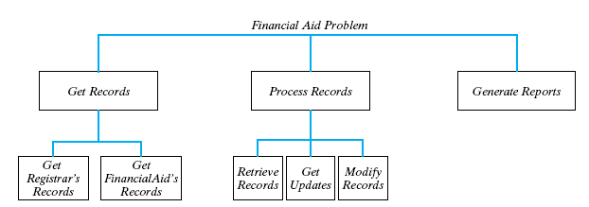
Top Down Design
Original problem partitioned into simpler subproblems
Each of these subproblems likewise subdivided

Slide 9
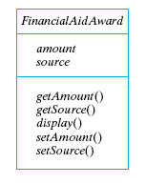
OOD: Object-Oriented Design
When to use while loop, do while loop
Identify the objects in the problem's specification and their types.
Identify the operations or tasks to manipulate the objects
Student 1
Name
ID
Gender
Course
9

Slide 10
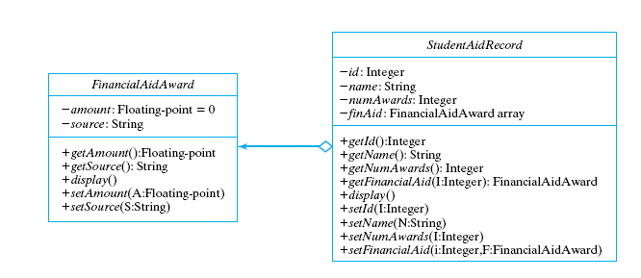
OOD: Object-Oriented Design
UML class diagram

Slide 11
Data Types of the Objects
Simple
Structured
arrays
structures
class objects
Think of them as Containers

Slide 12
Algorithms
Pseudo code
Must be
Definite, unambiguous
Simple
Finite
correct and efficient
well structured
Cannot separate data structures from algorithms

Slide 13
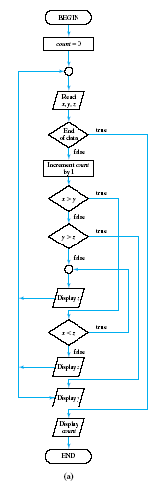
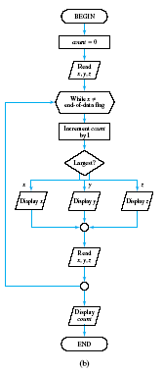
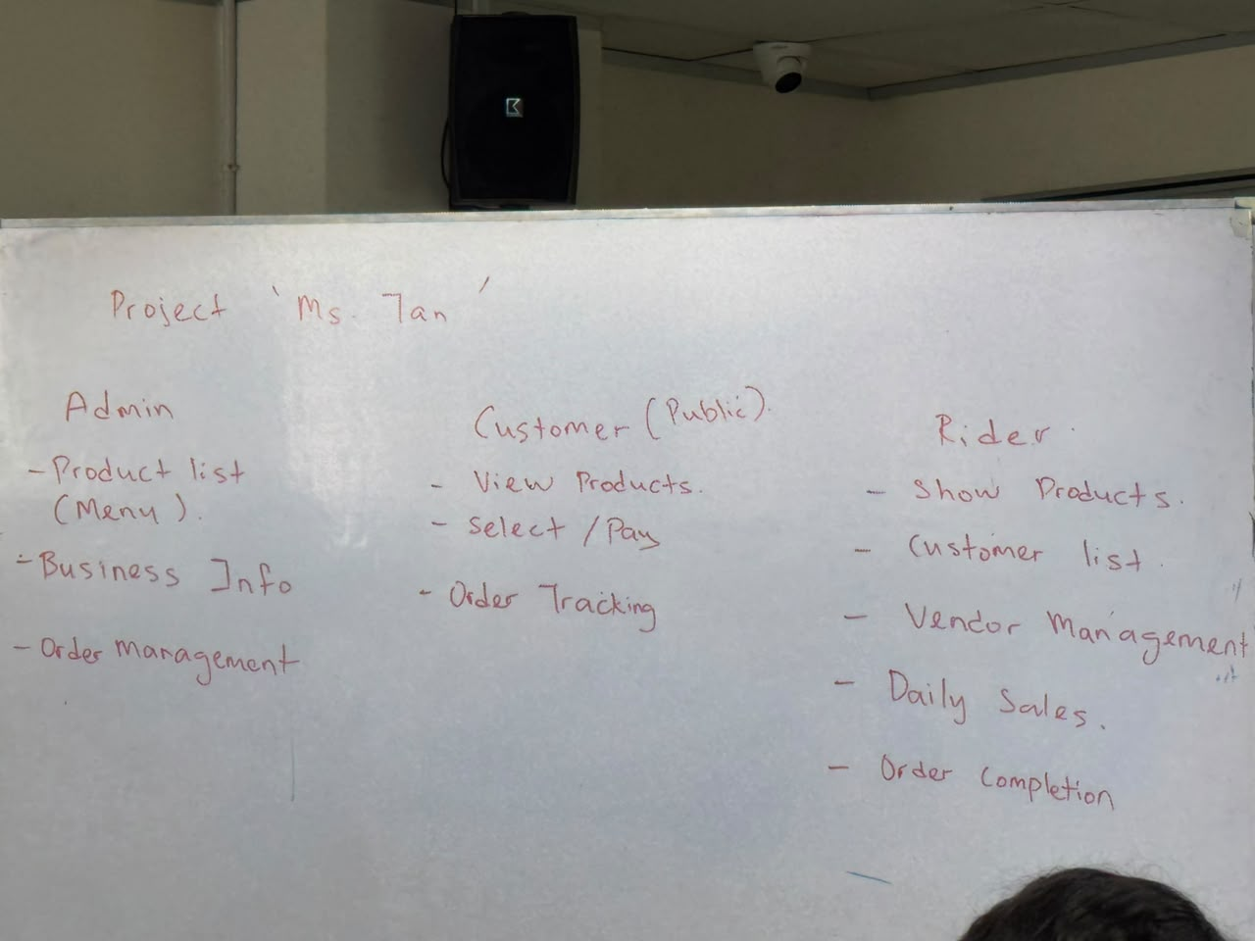
Algorithms
Structured
while loop
switch stmt
Unstructured
goto's
if-else's

Slide 14
Coding
Select language of implementation
Encode the design
Example
Figure 1.9 Financial-aid update function
Figure 1.10 Test-driver for Financial-aid update function
Figure 1.11 Header file for FinancialAidAward class
Figure 1.12 Implementation file for FinancialAidAward class
14

Slide 15
Coding
Verify integration
combining program units into a complete software system.
Insure quality
programs must be correct, readable, and understandable
well-structured, documented, formatted for readability

Slide 16
Testing, Execution, and Debugging
Validation: "Are we building the right product?"
check that documents, program modules, etc. match the customer's requirements.
Verification: "Are we building the product right?"
check that products are correct,
complete,
consistent with each other and with those of the preceding phases.
16

Slide 17
Different Kinds Of Tests Required
Unit tests:
Each individual program unit works?
Program components tested in isolation
Integration tests :
Units combined correctly?
Component interface and information flow tested
System tests:
Overall system works correctly?
17

Slide 18
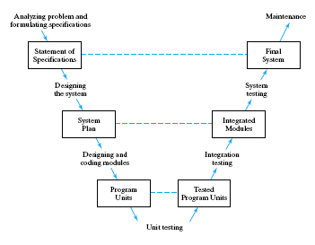
The "V" Life Cycle Model

Slide 19
Types of Errors
Syntax errors
errors in the grammar of the programming language
Run-time errors
happen during program execution
Logic errors
errors in algorithm design

Slide 20
Black Box or Functional Test
Outputs produced for various inputs
Checked for correctness
Do not consider structure of program component itself.
Program unit is viewed as a black box
Accepts inputs and produces outputs,
Inner workings of the box are not visible.
20

Slide 21
White Box or Structural Test
Performance is tested
examine code’s internal structure.
Test data is carefully selected
specific parts of the program unit are exercised.
21

Slide 22
Maintenance
Large % of
Computer center budgets
Programmer's time
Software development cost
Because …
Includes modifications and enhancements
Poor structure, poor documentation, poor style
Bug finding and fixing is tougher
Impedes implementation of enhancements
22

